Slide 1
React

Slide 2
json data server
npm install -g json-server
# 또는
yarn global add json-server

Slide 3
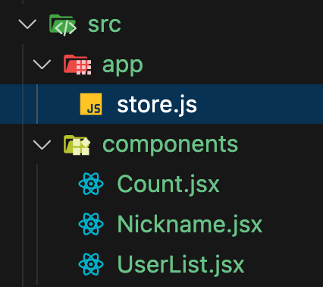
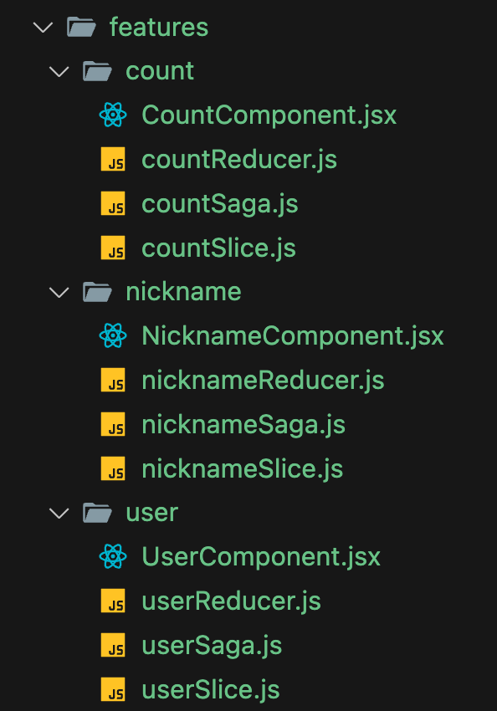
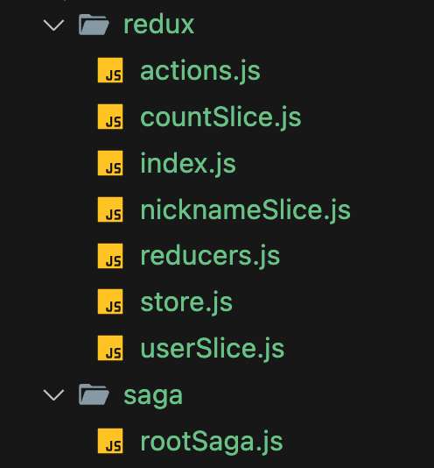
폴더 구조

Slide 4
db.json

Slide 5
{
"users": [
{ "id": 1, "name": "Alice", "age": 30, "email": "alice@example.com", "city": "New York" },
{ "id": 2, "name": "Bob", "age": 25, "email": "bob@example.com", "city": "Los Angeles" },
{ "id": 3, "name": "Charlie", "age": 35, "email": "charlie@example.com", "city": "Chicago" },
{ "id": 4, "name": "David", "age": 28, "email": "david@example.com", "city": "Houston" },
{ "id": 5, "name": "Eve", "age": 22, "email": "eve@example.com", "city": "Phoenix" },
{ "id": 6, "name": "Jona", "age": 40, "email": "jona@example.com", "city": "Philadelphia" },
{ "id": 7, "name": "Kim", "age": 31, "email": "kim@example.com", "city": "San Antonio" }
], }

Slide 6
"products": [
{ "id": "A1", "name": "Laptop", "price": 1200, "category": "Electronics", "inStock": true },
{ "id": "B2", "name": "Mouse", "price": 25, "category": "Electronics", "inStock": true },
{ "id": "C3", "name": "Keyboard", "price": 75, "category": "Electronics", "inStock": false },
{ "id": "D4", "name": "Monitor", "price": 300, "category": "Electronics", "inStock": true },
{ "id": "E5", "name": "Tablet", "price": 450, "category": "Electronics", "inStock": true },
{ "id": "F6", "name": "Smartphone", "price": 900, "category": "Electronics", "inStock": true },
{ "id": "G7", "name": "Headphones", "price": 150, "category": "Electronics", "inStock": false },
{ "id": "H8", "name": "T-Shirt", "price": 20, "category": "Apparel", "inStock": true },
{ "id": "I9", "name": "Jeans", "price": 60, "category": "Apparel", "inStock": true },
{ "id": "J10", "name": "Book", "price": 15, "category": "Books", "inStock": true }
]
}

Slide 7
package.json

Slide 8
{
"name": "my-json-server-project",
"version": "1.0.0",
"description": "",
"main": "index.js",
"scripts": {
"start": "json-server --watch db.json --port 3001"
},
"keywords": [],
"author": "",
"license": "ISC",
"dependencies": {
"json-server": "^0.17.4" // 예시 버전l
}
}

Slide 9
실행 명령어
json-server --watch db.json --port 3001

Slide 10
라이브러리
npm install redux-saga react-redux redux
or
yarn add redux-saga react-redux redux

Slide 11
app/store.js

Slide 12
import { configureStore } from '@reduxjs/toolkit';
import createSagaMiddleware from 'redux-saga';
import countReducer from '../features/count/countReducer';
import nicknameReducer from '../features/nickname/nicknameReducer';
import userReducer from '../features/user/userReducer';
import rootSaga from '../saga/rootSaga';
const sagaMiddleware = createSagaMiddleware();
const store = configureStore({
reducer: {
count: countReducer,
user: userReducer,
nickname: nicknameReducer,
},
middleware: (getDefaultMiddleware) => getDefaultMiddleware({ thunk: false }).concat(sagaMiddleware),
});
sagaMiddleware.run(rootSaga);
export default store;

Slide 13
features/count/CountComponent.jsx

Slide 14
// CountComponent.jsx
import React from 'react';
import { useSelector, useDispatch } from 'react-redux';
import { increase, decrease } from './countSlice';
export default function CountComponent() {
const value = useSelector((state) => state.count.value);
const dispatch = useDispatch();
return (
<div>
<h2>Count: {value}</h2>
<button onClick={() => dispatch(increase())}>Increase</button>
<button onClick={() => dispatch(decrease())}>Decrease</button>
</div>
);
}

Slide 15
featurs/count/countReducer.js

Slide 16
// features/countReducer.js
import { INCREASE_SUCCESS, DECREASE_SUCCESS } from './countSlice';
const initialState = {
value: 0,
};
const countReducer = (state = initialState, action) => {
switch (action.type) {
case INCREASE_SUCCESS:
return { ...state, value: state.value + 1 };
case DECREASE_SUCCESS:
return { ...state, value: state.value - 1 };
default:
return state;
}
};
export default countReducer;

Slide 17
features/count/countSaga.js

Slide 18
// features/countSaga.js
import { put, takeEvery } from 'redux-saga/effects';
import { INCREASE, DECREASE, INCREASE_SUCCESS, DECREASE_SUCCESS } from './countSlice';
function* increaseSaga() {
yield put({ type: INCREASE_SUCCESS });
}
function* decreaseSaga() {
yield put({ type: DECREASE_SUCCESS });
}
export function* countSaga() {
yield takeEvery(INCREASE, increaseSaga);
yield takeEvery(DECREASE, decreaseSaga);
}

Slide 19
features/count/countSlice.js

Slide 20
// features/countSlice.js
export const INCREASE = 'count/INCREASE';
export const DECREASE = 'count/DECREASE';
export const INCREASE_SUCCESS = 'count/INCREASE_SUCCESS';
export const DECREASE_SUCCESS = 'count/DECREASE_SUCCESS';
export const increase = () => ({ type: INCREASE });
export const decrease = () => ({ type: DECREASE });

Slide 21
features/nickname/NicknameComponent.jsx

Slide 22
import React from 'react';
import { useSelector, useDispatch } from 'react-redux';
import { changeInput } from './nicknameSlice';
export default function NicknameComponent() {
const { name, nickname } = useSelector((state) => state.nickname);
const dispatch = useDispatch();
const handleChange = (e) => {
const { name, value } = e.target;
dispatch(changeInput({ name, value }));
};
return (
<div>
<input name="name" value={name} onChange={handleChange} placeholder="Name" />
<input name="nickname" value={nickname} onChange={handleChange} placeholder="Nickname" />
<p>{name} ({nickname})</p>
</div>);}

Slide 23
features/nickname/nicknameReducer.js

Slide 24
// features/nickname/nicknameReducer.js
import { CHANGE_INPUT_SUCCESS } from './nicknameSlice';
const initialState = {
name: '',
nickname: '',
};
const nicknameReducer = (state = initialState, action) => {
switch (action.type) {
case CHANGE_INPUT_SUCCESS:
const { name, value } = action.payload;
return {
...state,
[name]: value,
};
default:
return state;}};
export default nicknameReducer;

Slide 25
features/nickname/nicknameSaga.js

Slide 26
// features/nickname/nicknameSaga.js
import { takeEvery, put } from 'redux-saga/effects';
import { CHANGE_INPUT, CHANGE_INPUT_SUCCESS } from './nicknameSlice';
function* changeInputSaga(action) {
// 필요한 비동기 작업이 있다면 여기에 작성 (예: 로깅, 유효성 검증 등)
yield put({ type: CHANGE_INPUT_SUCCESS, payload: action.payload });
}
export function* nicknameSaga() {
yield takeEvery(CHANGE_INPUT, changeInputSaga);
}

Slide 27
features/nickname/nicknameSlice.js

Slide 28
// features/nickname/nicknameSlice.js
export const CHANGE_INPUT = 'nickname/CHANGE_INPUT';
export const CHANGE_INPUT_SUCCESS = 'nickname/CHANGE_INPUT_SUCCESS';
export const changeInput = (payload) => ({
type: CHANGE_INPUT,
payload,
});
.

Slide 29
features/user/UserComponent.jsx

Slide 30
import React, { useEffect } from 'react';
import { useSelector, useDispatch } from 'react-redux';
import { fetchUsers } from './userSlice';
const UserComponent = () => {
const dispatch = useDispatch();
const { loading, data: users, error } = useSelector((state) => state.user);
useEffect(() => {
dispatch(fetchUsers());
}, [dispatch]);

Slide 31
return (
<div>
<h1>사용자 목록</h1>
{loading && <p>사용자 데이터를 불러오는 중...</p>}
{error && <p>에러 발생: {error}</p>}
{!loading && users.length === 0 && <p>사용자 데이터가 없습니다.</p>}
<ul>
{users.map((user) => (
<li key={user.id}>
<strong>{user.name}</strong> ({user.age}세, {user.city}) - {user.email}
</li>
))}
</ul>
</div>);};
export default UserComponent;

Slide 32
features/user/userReducers.js

Slide 33
// features/users/userReducer.js
import {
FETCH_USERS,
FETCH_USERS_SUCCESS,
FETCH_USERS_FAILURE,
} from './userSlice';
const initialState = {
loading: false,
data: [],
error: null,
};

Slide 34
const userReducer = (state = initialState, action) => {
switch (action.type) {
case FETCH_USERS:
return { ...state, loading: true, error: null };
case FETCH_USERS_SUCCESS:
return { ...state, loading: false, data: action.payload };
case FETCH_USERS_FAILURE:
return { ...state, loading: false, error: action.payload };
default:
return state;
}
};
export default userReducer;

Slide 35
features/user/userSaga.js

Slide 36
// features/users/userSaga.js
import { call, put, takeLatest } from 'redux-saga/effects';
import axios from 'axios';
import {
FETCH_USERS,
FETCH_USERS_SUCCESS,
FETCH_USERS_FAILURE,
} from './userSlice';
function* fetchUsersSaga() {
try {
const response = yield call(axios.get, 'http://localhost:3001/users');
yield put({ type: FETCH_USERS_SUCCESS, payload: response.data });
} catch (error) {
yield put({ type: FETCH_USERS_FAILURE, payload: error.message });}}
export function* userSaga() {
yield takeLatest(FETCH_USERS, fetchUsersSaga);
}

Slide 37
features/user/userSlice.js

Slide 38
// features/users/userSlice.js
export const FETCH_USERS = 'users/FETCH_USERS';
export const FETCH_USERS_SUCCESS = 'users/FETCH_USERS_SUCCESS';
export const FETCH_USERS_FAILURE = 'users/FETCH_USERS_FAILURE';
export const fetchUsers = () => ({ type: FETCH_USERS });

Slide 39
saga/rootSaga.js

Slide 40
// rootSaga.js
import { all } from 'redux-saga/effects';
import { countSaga } from '../features/count/countSaga';
import { nicknameSaga } from '../features/nickname/nicknameSaga';
import { userSaga } from '../features/user/userSaga';
export default function* rootSaga() {
yield all([countSaga(), nicknameSaga(), userSaga()]);
}

Slide 41
src/index.js

Slide 42
import React from 'react';
import ReactDOM from 'react-dom/client';
import './index.css';
import App from './App';
import { Provider } from 'react-redux';
// import store from './redux/store';
import store from './app/store';
const root = ReactDOM.createRoot(document.getElementById('root'));
root.render(
<Provider store={store}>
<App />
</Provider>
);

